Slide 1

Predicting Stroke Risk Using Hybrid Deep Transfer Learning Models
Presented To:
Final year Capstone Project Committee
Department of Computer Science & Engineering
Internal Guide:
Mr. Ajay Kumar Badhan
Assistant Professor, CSE
Presented By:
Abburi Naveen Varma 12018007
Morrigadudhula Abhinay 12020232
Mattapalli Veerasai 12009148
Bavanari Anilkumar 12014545
Somishetty Sanjay Varma 12007391
Chinda Harsha Vardhan Raju 12016603

Slide 2
CONTENT
Abstract
Introduction
Objectives
Literature Survey
Existing System
Proposed System
Flow Diagram
Modules
Result
System Requirements
Conclusion
References

Slide 3
Abstract
Our study introduces a novel approach, combining deep neural networks with transfer learning, to predict stroke risk. Utilizing a healthcare dataset, we preprocess the data, encode categorical variables, and train Decision Tree and Random Forest classifiers. Results highlight the hybrid model's effectiveness in accurately predicting stroke risk, showcasing its potential to augment healthcare analytics and provide valuable insights for preventive interventions. This hybrid deep transfer learning framework offers a promising avenue for enhancing stroke risk prediction models, thereby contributing to improved patient care and health outcomes.

Slide 4
INTRODUCTION
Stroke is one of the most prevalent diseases which could lead to death or long-term disability among elderly people all over the world. In a recent report, around 795 000 people experience a new or recurrent stroke each year in the US; one stroke incident occurs in approximately every 40 seconds.
Among the patients who suffered strokes, one in five would die within one year. For the survivals, the cost of treatment and rehabilitation becomes an extremely high burden to their families and the health-care system.
From 2014 to 2015, the direct and indirect cost due to stroke incidents was about 45.5 billion US dollars.
Thus, accurate stroke prediction is highly desirable so that the cost can be reduced with early interventions to delay the onset of and to reduce the risks of stroke.

Slide 5
OBJECTIVES
The main objective of our project is
To predict or to classify the stroke or non-stroke effectively.
To implement the feature selection for selecting the best features from our dataset.
To implement the different machine learning algorithm.
To enhance the overall performance analysis.

Slide 6
LITERATURE SURVEY
Ref No. | Paper Title | Methodology | Merits | Demerits | Year
1. | Stroke Risk Prediction With Hybrid Deep Transfer Learning Framework | Combine the outputs of multiple deep learning models, possibly including both CNNs and RNNs, Assess the performance of the hybrid deep transfer learning framework using appropriate evaluation metrics such as accuracy, precision. | It has the enhanced prediction accuracy, Transfer learning allows the integration of knowledge from diverse domains (e.g., images, text) into stroke risk prediction and reduces the training time | This led to overfitting if the pre-trained models are not appropriately fine-tuned Transfer learning may inadvertently transfer biases present in the pre-trained models | 2022
2. | An Integrated Machine Learning Approach to Stroke Prediction | We propose a novel automatic feature selection algorithm that selects robust features based on our proposed heuristic: conservative mean. Combined with Support Vector Machines (SVMs) | Machine learning algorithms are capable of identifying features highly related to stroke occurrence efficiently from the huge set of features | Prediction is poor | 2020
3. | Performance Analysis of Machine Learning Approaches in Stroke Prediction | Ten different classifiers have been trained for predicting the stroke. Afterwards, results of the base classifiers have been aggregated using the weighted voting approach to reach highest accuracy | The results of the base classifiers have been aggregated using the weighted voting approach to reach highest accuracy. | The prediction is not accurate. | 2020

Slide 7
LITERATURE SURVEY
Ref No. | Paper Title | Methodology | Merits | Demerits | Year
1. | A machine learning-based approach for predicting the outbreak of cardiovascular diseases in patients on dialysis | We tested different types of algorithm (both linear and non-linear), but the final choice was to use Support Vector Machine. We obtained the best performances using the non-linear SVC with RBF kernel algorithm, optimizing it with Grid Search. | The prediction is accurate. | Time consumption is high and has theoretical limits | 2020
2. | Chronic Heart Failure Detection from Heart Sounds Using a Stack of Machine-Learning Classifiers | The method consists of filtering, segmentation, feature extraction and machine learning. The method was tested with a leave-one-subject-out evaluation technique on data from 122 subjects, gathered in the study | The decision tree resulted in an average accuracy of 93%, which is higher than the other algorithm | The prediction is not accurate and has Less prediction | 2019
3. | Stroke Prediction Using Machine Learning in a Distributed Environment | There is a need to design an approach to predict whether a person will be affected by stroke or not. This paper analyse different machine learning algorithms for better prediction of stroke problem. The algorithms used for analysis include Naive Bayes, Logistic Regression, Decision Tree, Random Forest | Training time is low. | Error rate is high. | 2019

Slide 8
EXISTING SYSTEM
In existing, the system is proposed a novel Hybrid Deep Transfer Learning-based Stroke Risk Prediction (HDTL-SRP) framework which consists of three key components:
(1) Generative Instance Transfer (GIT) for making use of the external stroke data distribution among multiple hospitals while preserving the privacy,
(2) Network Weight Transfer (NWT) for making use of data from highly correlated diseases (i.e., hypertension or diabetes),
(3) Active Instance Transfer (AIT) for balancing the stroke data with the most informative generated instances.
It is found that the proposed HDTL-SRP framework outperforms the state-of-the-art SRP models in both synthetic and real-world scenarios.

Slide 9
DISADVANTAGES
It doesn’t efficient for large volume of data’s
Theoretical limits.
The process is implemented without removing unwanted data.
The prediction is not accurate.

Slide 10
PROPOSED SYSTEM
In this system, the stroke dataset was taken as input. The input data was taken from the dataset repository. Then, we have to implement the data preprocessing step.
In this step, we have to handle the missing values for avoid wrong prediction. Then, we have to use label encoding, to encode the label for input data. To encode the columns into numeric values.
After that, we can implement the feature selection such as chi square for selecting the best features from pre-processed data.
Next, we have to implement the data splitting. In this step, we have to split the data into test and train.
Then, we have to implement the deep and machine learning algorithms such as Convolutional Neural Network (CNN) , Decision Tree, Random Forest (RF). Finally, the experimental results shows that the performance metrics such as accuracy, precision, recall, f1-score and comparison graph.

Slide 11
ADVANTAGES
It is efficient for large number of datasets.
To increase the performance metrics results.
Time consumption is low.
The process is implemented with removing unwanted data.

Slide 12

Flow Diagram
Input data
Preprocessing
Handling missing values
Label Encoding
Stroke dataset
Feature Selection
Chi Square
Test Data
Random Forest
Train Data
Data Splitting
Decision Tree
CNN
Stroke
Classification
Normal
Accuracy
Precision
Performance Estimation
Visualization
Recall
F1 score

Slide 13
MODULES
Data selection
Data preprocessing
Feature Selection
Data splitting
Classification
Prediction
Performance analysis

Slide 14
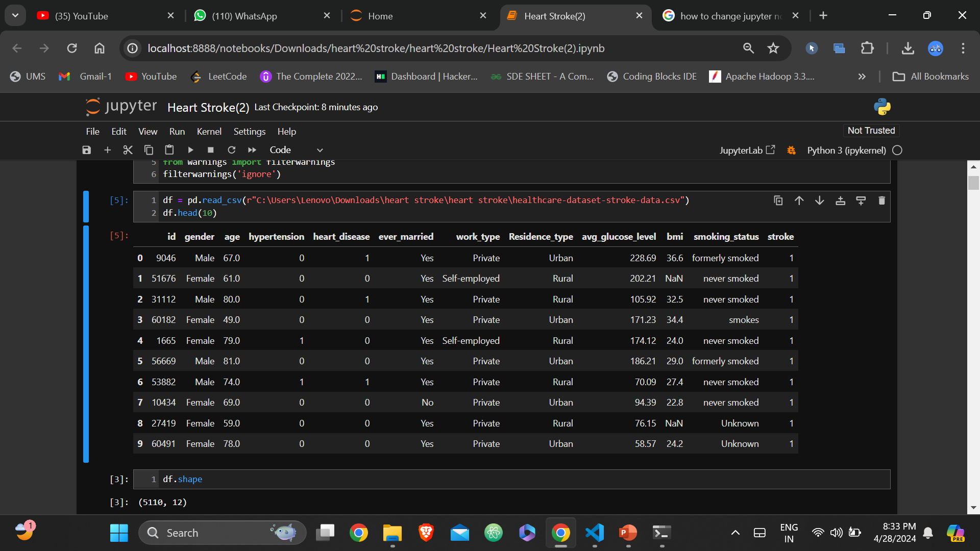
DATA SELECTION
The input data was collected from dataset repository like UCI, GitHub and Kaggle and so on.
In our process, the stroke dataset is used.
The dataset contains the information about the
patient such as id, age, gender, hypertension, heart disease,
ever married, work type, Residence type, average glucose level,
Body Mass Index( BMI ),smoking status and stroke.
With the help of panda’s package, we can read our input dataset.
The dataset is in the format “.csv”.
IMAGE

Slide 15
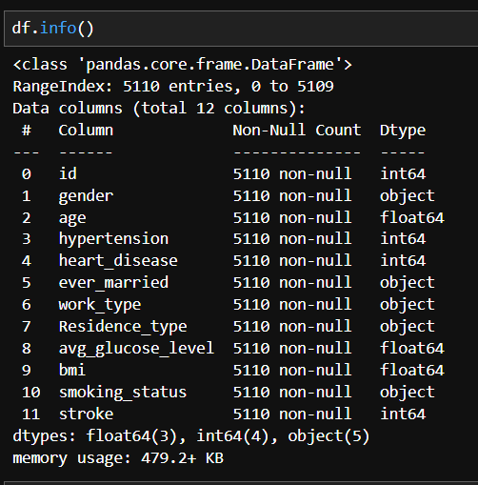
DATA PREPROCESSING
Data pre-processing is the process of removing the unwanted data from the dataset.
Pre-processing data transformation operations are used
to transform the dataset into a structure suitable for machine learning.
Missing data removal: In this process, the null values
such as missing values and Nan values are replaced by 0.
Encoding Categorical data: That categorical data is defined as
variables with a finite set of label values.
That most machine learning algorithms require numerical input and output variables.

Slide 16
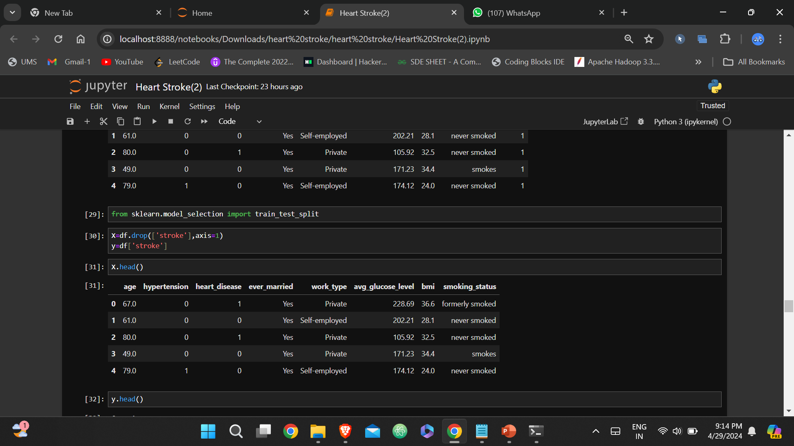
FEATURTE SELECTION
In our process, we have to implement the feature selection
for selecting the best features such as chi square and correlation.
Then, we have to hybrid the two different feature selection
techniques such as chi square and correlation.
A chi-square test is used in statistics to test the
independence of two events. Given the data of two variables,
we can get observed count O and expected count E.
Chi-Square measures how expected count E and observed
count O deviates each other.

Slide 17
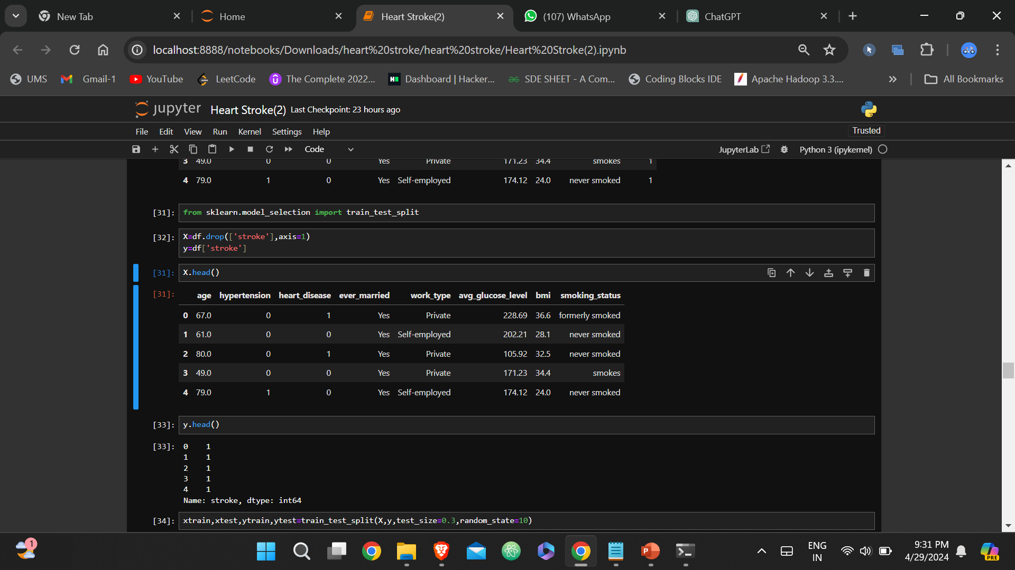
DATA SPLITTING
During the machine learning process, data are needed so that learning can take place.
In addition to the data required for training, test data are needed to evaluate the performance of the algorithm in order to see how well it works.
In our process, we considered 80% of the disease dataset to be the training data and the remaining 20% to be the testing data.
Data splitting is the act of partitioning available data into two portions, usually for cross-validator purposes.
One Portion of the data is used to develop a predictive model and the other to evaluate the model's performance.
IMAGE

Slide 18
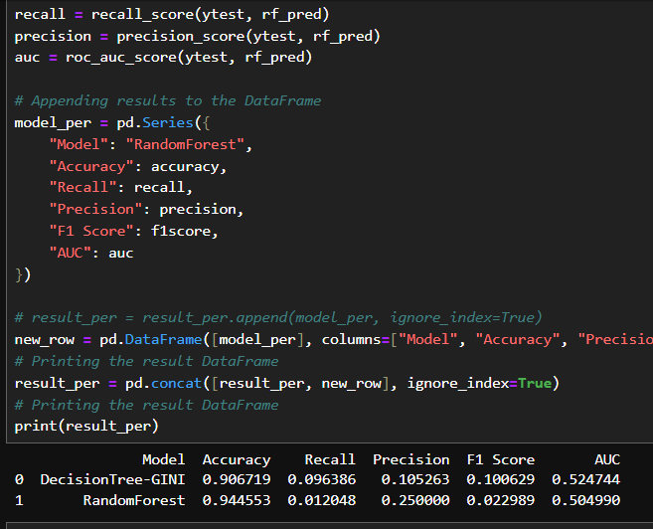
CLASSIFICATION
In our process, we can implement the different classification algorithms such as random forest and multi-layer perceptron.
Random forest is a Supervised Machine Learning Algorithm that is used widely in Classification and Regression problems. It builds decision trees on different samples and takes their majority vote for classification and average in case of regression.
Decision Tree a popular machine learning algorithm used for both classification and regression tasks. It is a predictive modeling tool that learns to partition the data space into a series of rectangular regions and predicts the target variable's value based on the input features.

Slide 19
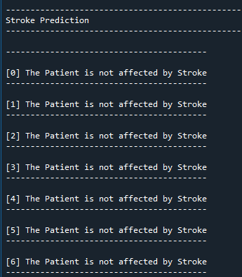
PREDICTION
In this step, we have to predict the patient is affected by disease or not by using the classification algorithms.

Slide 20
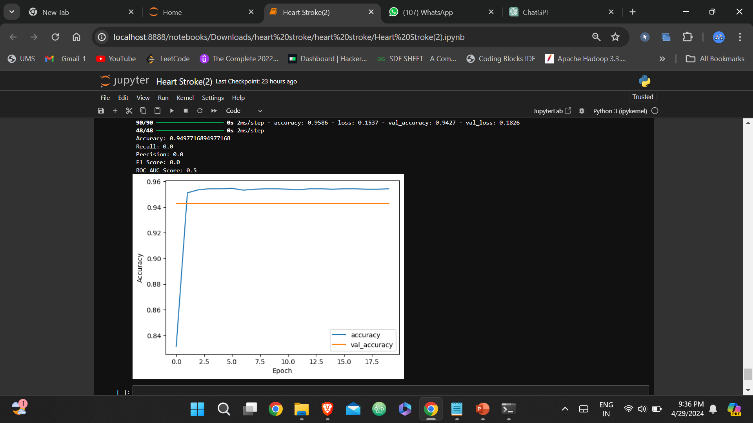
RESULT

Slide 21
SYSTEM REQUIREMENTS
SOFTWARE REQUIREMENTS:
O/S : Windows 10.
Language : Python
Front End : JUPYTER NOTEBOOK
HARDWARE REQUIREMENTS:
System : Pentium IV 2.4 GHz
Hard Disk : 200 GB
Ram : 4GB

Slide 22
CONCLUSION
We conclude that, the proposed system was implemented or developed the different classification algorithm for predicting or classifying the disease either the patient is affected by stroke or not effectively by using Multi-Layer Perceptron (MLP), Decision Tree and Random Forest (RF).
Then, the system was developed the feature selection technique for selecting the best features from our dataset.
The experimental results shows that some performance metrics such as accuracy, precision, recall and f1-score. Then, we are compared the two algorithms effectively.

Slide 23
REFERENCES
[1] Cui, L., Fan, Z., Yang, Y., Li, R., Wang, D., Feng, Y., … & Fan, Y. (2022). Deep learning in ischemic stroke imaging analysis: a comprehensive review. BioMed Research International, 2022, 1-15.
[2] Wei, Z., Li, M., & Fan, H. (2022). Hybrid deep learning model for the risk prediction of cognitive impairment in stroke patients.
[3] Chantamit-o-pas, P. and Goyal, M. (2017). Prediction of stroke using deep learning model. Neural Information Processing, 774-781.
[4] S. V, R. and R, G. (2023). Hybrid deep transfer learning framework for stroke risk prediction. The International Conference on Scientific Innovations in Science, Technology, and Management.
[5] Rao, B. N., Mohanty, S., Sen, K., Acharya, U. R., Cheong, K. H., & Sabut, S. (2022). Deep transfer learning for automatic prediction of hemorrhagic stroke on ct images. Computational and Mathematical Methods in Medicine, 2022, 1-10.

Slide 24
REFERENCES
[6] Cheon, S., Kim, J., & Lim, J. (2019). The use of deep learning to predict stroke patient mortality. International Journal of Environmental Research and Public Health, 16(11), 1876.
[7] AlArfaj, A. A., Mahmoud, H. A. H., & Hafez, A. M. (2022). A deep learning model for stroke patients’ motor function prediction. Applied Bionics and Biomechanics, 2022, 1-9.
[8] Liu, Y., Yu, Y., Ouyang, J., Jiang, B., Yang, G., Ostmeier, S., … & Zaharchuk, G. (2023). Functional outcome prediction in acute ischemic stroke using a fused imaging and clinical deep learning model. Stroke, 54(9), 2316-2327.
[9] Su, S., Li, L., Wang, Y., & Li, Y. (2023). Stroke risk prediction by color Doppler ultrasound of carotid artery-baseddeep learning using Inception V3 and VGG-16. Frontiers in Neurology, 14.
[10] Lee, J.H., Kwon, J., Lee, M.S., Cho, Y., Oh, I., Park, J.J., & Jeon, K. (2022). Prediction of atrial fibrillation in patients with embolic stroke with undetermined source using electrocardiogram deep learning algorithm and clinical risk factors. European Heart Journal.

Slide 25


